Slide 1
Team Alpha
Final Presentation
CSC 440 : December 4, 2023

Slide 2
Have we achieved our goal of creating a next-generation Wiki platform where users can trust the information?

Slide 3

Yes! Overwhelmingly!

Slide 4
We added:
Multi Factor Authentication and reCAPTCHA checks
User registration
History Log for Page Entries
User experience survey

Slide 5
Project Testing
11 Unit Tests covering our features
2 Integration Tests covering data transfer between feature, route, and JSON file
1 Acceptance Test successfully completed by 2 non-technical users

Slide 6
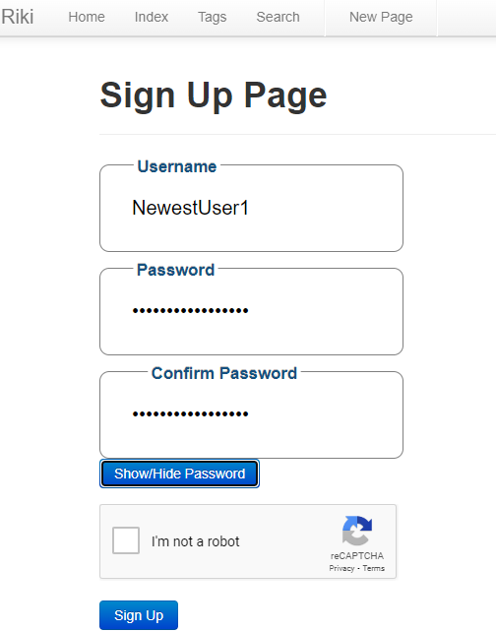
Account Sign Up Implementation

Slide 7
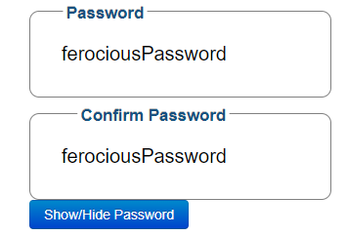
Can hide/unhide password

Slide 8
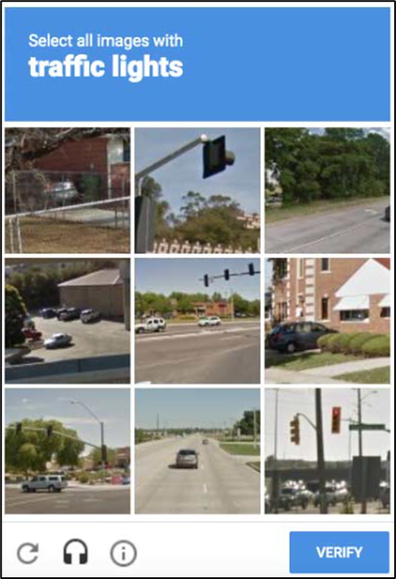
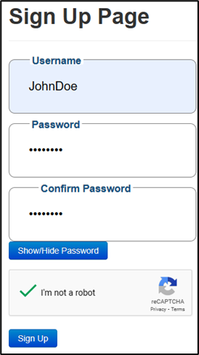
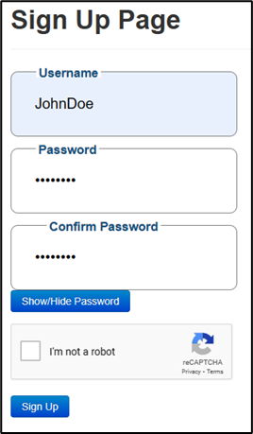
reCAPTCHA Implementation

Slide 9
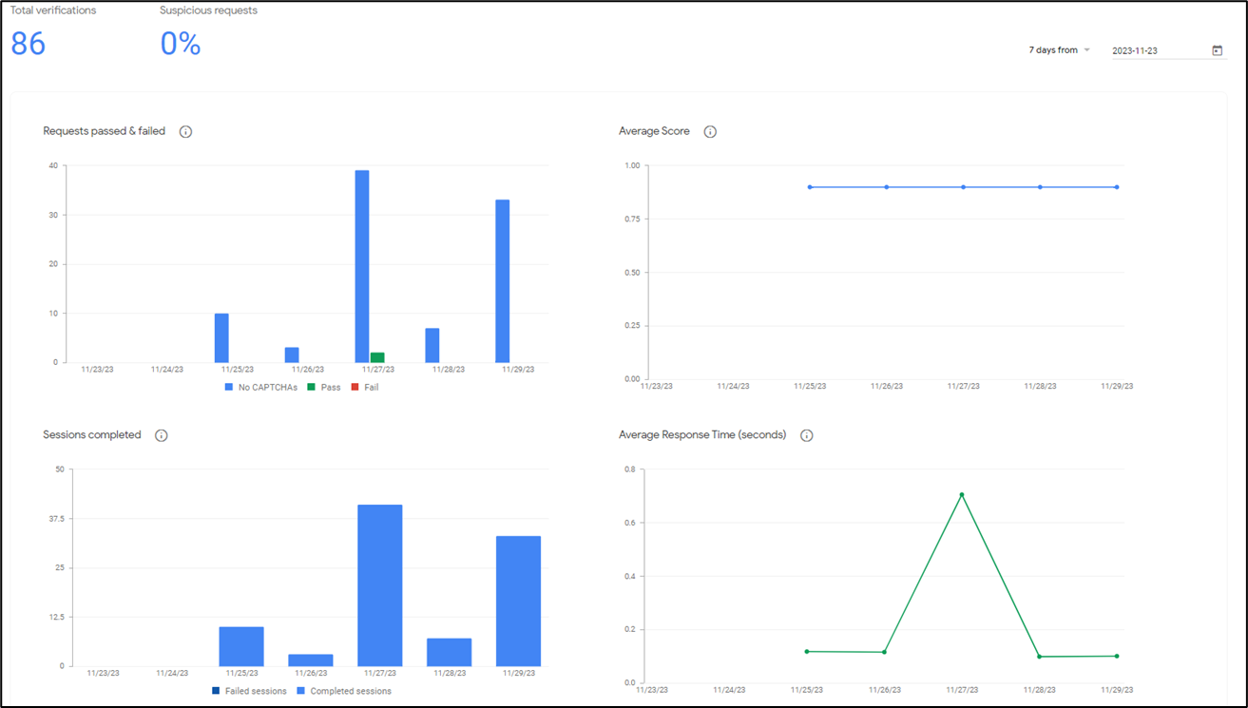

Slide 10


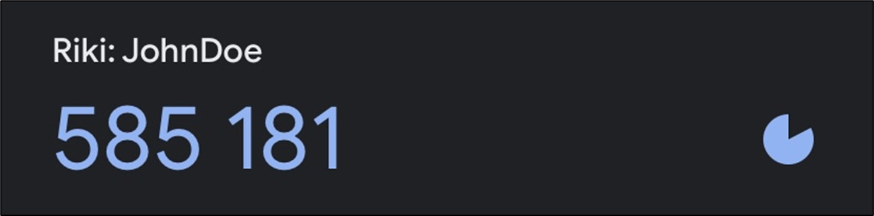
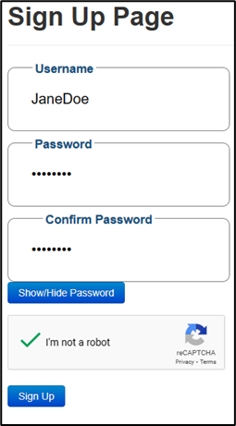
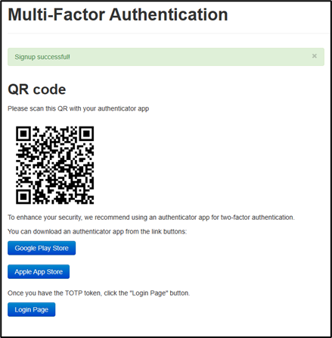
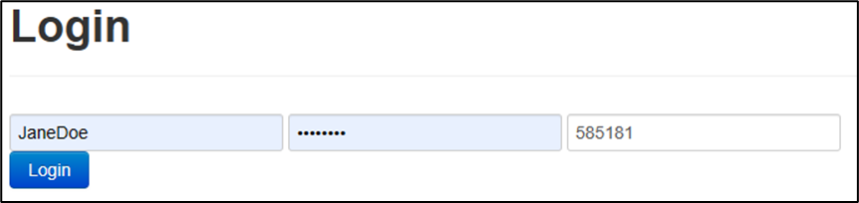
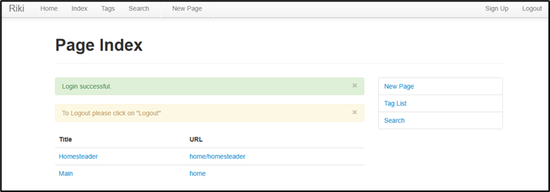
Multi Factor Authentication Implementation
Register and Login process with reCAPTCHA and MFA

Slide 11
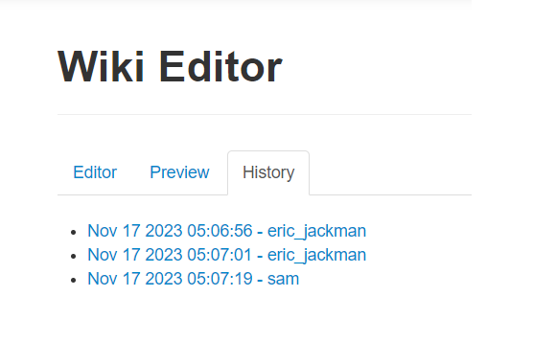
History Log for Page Entries Implementation

Slide 12
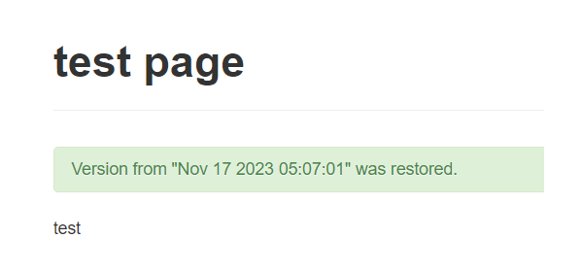
Clicking on the version restores the page

Slide 13
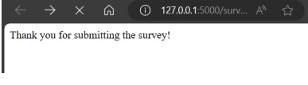
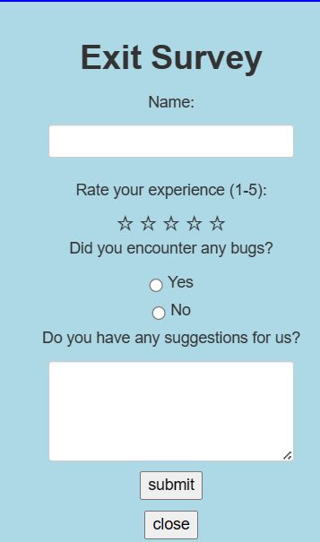
User Exit Survey

Slide 14
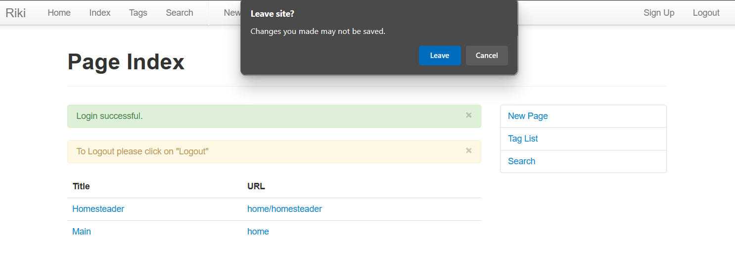

Slide 15
Lessons Learned
Stay current with the main git branch to avoid merge conflicts!
Communicate, communicate, communicate!
Start earlier than early, and finish as fast as humanly possible!

Slide 16
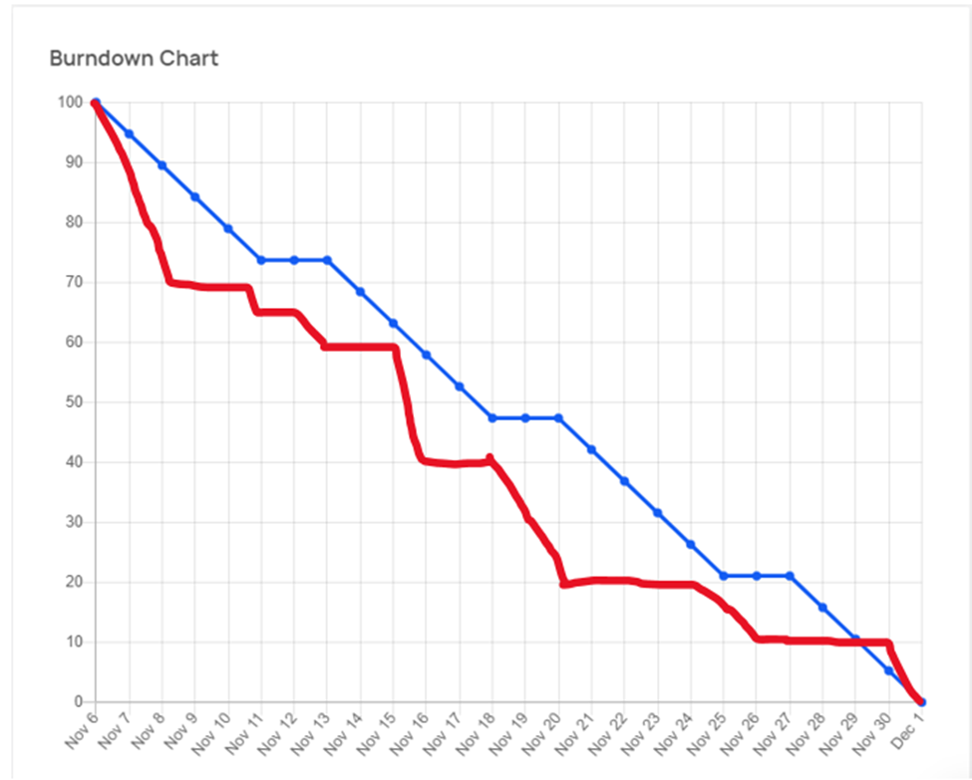

Slide 17
Initial LoC: 215,122
Final LoC: 215,864
Total LoC Written: 742!

